Slide 1
"Brief Introduction to Running GNU/Linux servers, Containers (Docker), and Hyper-Converged Deployments"
Woodlands Computer Science
Meeting 13

Slide 2
Meeting Overview
Introductory understanding of GNU/Linux servers, containers (Docker specifically) and Virtual Machine ("Hyper-Converged") deployments
Focusing mostly on containers as it's the new hot-topic nowadays (it is probably also more practical)
Briefly talk about Kubernetes but we won't be showing how to use it (maybe for another meeting?)
Live demo on headless Linux servers in VMs and using Docker

Slide 3
Why Linux-based Operating Systems?
This applies especially for servers but also personal systems!
Performance
Linux requires fewer resources than operating systems such as Windows and performs well on all computers
Very stable, rarely need to reboot, rarely crashes or updates
Control
Many CLI (and GUI) tools
Powerful terminal
Modularity
Security
Better privilege assignment, can control what can be accessed by users and services
Less viruses are made for Linux
Free and great public support!
Some commonly used Linux distributions for servers: Debian, Ubuntu, Fedora Server and CoreOS, RHEL, CentOS (discontinued but alternatives exists), Alpine (great for Docker too!), other container based distributions

Slide 4
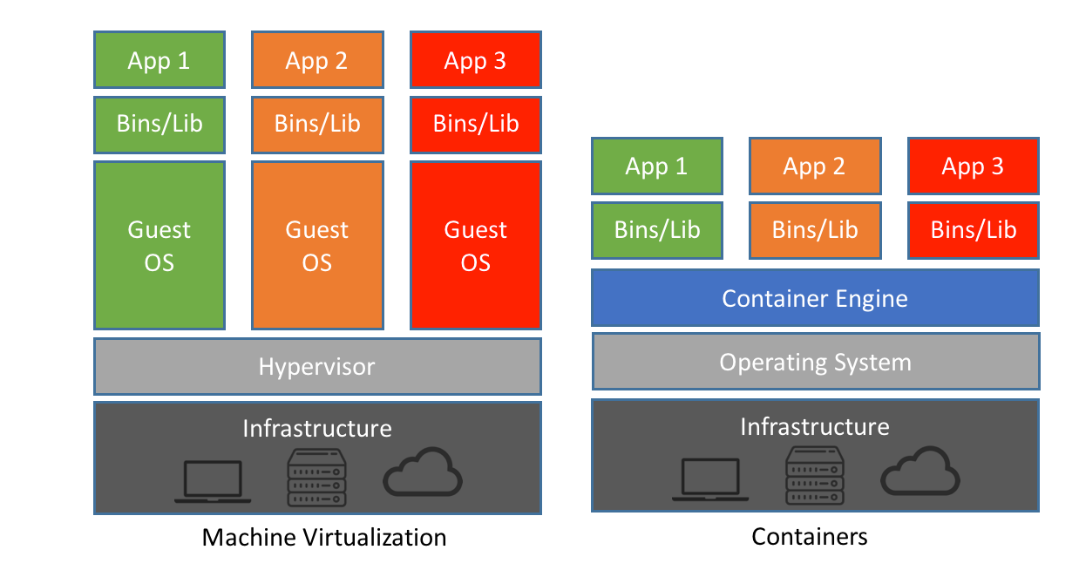
Virtual Machines or Containers?
Answer: It depends!
VMs emulate an entire computer system, and run unique operating systems.
Containers run on a "Container Host" which contain the container runtime and other processes to simulate a system.
VM Upsides
Better control over the system
Familiar to many users
Direct access to the hardware
Container Upsides
Less overhead
"Stateless" applications
Portable development environment
Reference:
https://blog.netapp.com/blogs/containers-vs-vms/

Slide 5
Use of Containers
There are many reasons to use containers:
Containers run the same no matter where they're deployed
Require less system resources, requires little disk space
Fast to start up, quick development
Containers share resources
Scales easily, simple to add more containers
More secure (easy to read Dockerfiles, harder to attack)

Slide 6

"Dockerfile" and "Docker Image"
Docker is a popular container runtime to run Docker containers with.
Docker images are built based on the Dockerfile which defines the steps to create an image and various other port and environment variable settings.
A docker image is built, then tagged and can be deployed across all systems with the Docker runtime
Sometimes, these images are "published" and a container registry to be able to download these images elsewhere.

Slide 7

Note about Kubernetes (k8s)
Kubernetes - Open source container platform developed by Google
Automates setup of deployment, scaling, container managing
Allows for HA (high-availability) setups and cluster of many nodes
To make Kubernetes useful, it must be combined with a number of other components. Kubernetes distributions make it much simpler.
Various runtimes are available; the main ones include Docker, CRI-O, Kata (imagine container VMs)
Kubernetes distributions make it easier to team together. Notable k8s distributions include: RKE, Canonical K8s, Red Hat Openshift (or upstream project is "OKD")
Other Cloud specific ones: Amazon Elastic Kubernetes Service, Azure Kubernetes Service, Google Kubernetes Engine

Slide 8
Docker Hub and Docker Components
Docker Hub is a "container registry" for Docker containers. People can publish their containers along with "tags". The Docker Engine runs on a container host and runs all tasks using the same program. This includes managing the images, networking, container runtime, persistent storage and communicating with the Docker CLI.
Docker Commands:
docker run - runs a command in a new container
docker exec - runs a command in a running container
docker rm/kill - removes/kills a container
docker login/logout - login to a docker registry
docker build - builds image from dockerfile
docker tag - creates a tag
docker push/pull - push/pull an image from a repository
docker ps - lists containers
docker stats - displays live container resource statistics
docker logs - fetches logs of a container

Slide 9
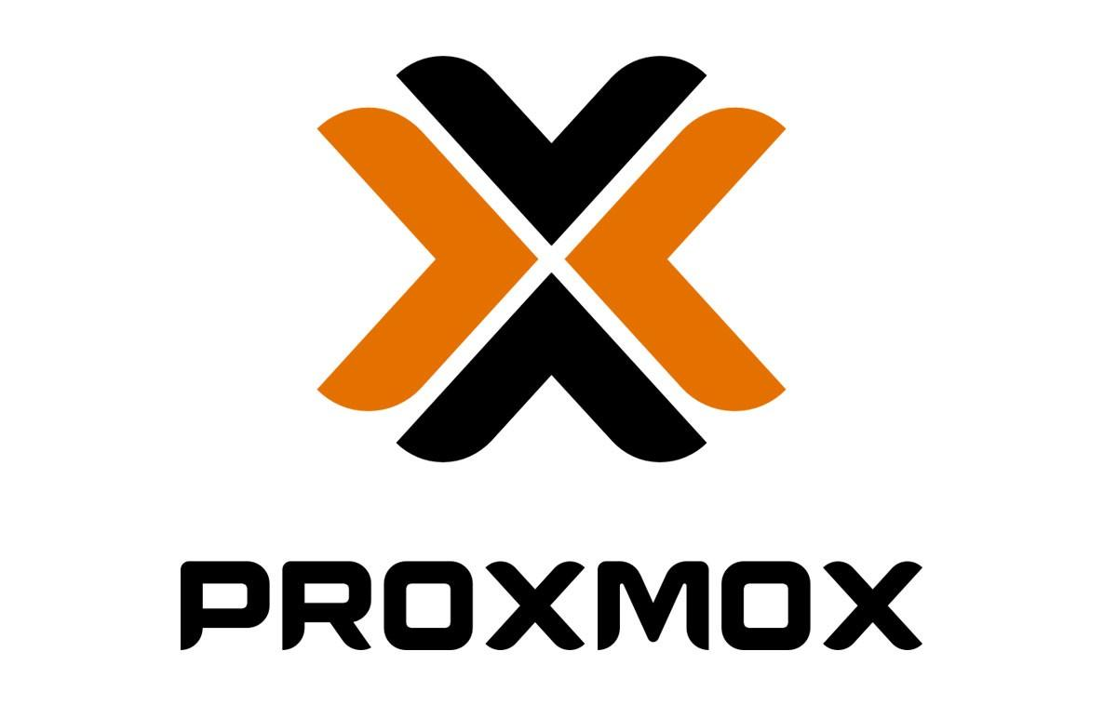

Demo
Creating virtual machines: demo on "Proxmox" (just because it's what I have already)
Installing Debian GNU/Linux on a VM
Connecting to network
Demonstrating how to interact with a server using SSH
Docker
Installing Docker
Creating and building a Docker image
Testing the Docker image
Running the Docker image in a container
Deploying a container
Next week's topic poll: https://forms.gle/moPrZ3TJTppspuup9

Slide 10
Links and Info for Demo
https://forms.gle/2nxQk8Qis4kvA9Js8
https://github.com/WoodlandsComputerScience/WCSBot2
https://nodejs.org/en/docs/guides/nodejs-docker-webapp/
https://hub.docker.com/_/node/
https://192.168.10.250:8006/#v1:0:=qemu%2F269:4:5
Some things in a GNU/Linux server
Packages (for APT): neofetch, openssh-server, vim, tmux, sudo, htop
User stuff: useradd, usermod, visudo, /etc/passwd
Networking: ip addr, macchanger?, /etc/hosts
Host information: /etc/hostname, uname, neofetch, htop
File System: /etc/fstab, df, fdisk
Services: systemd commands… dmesg, systemctl, journalctl -b

